Slide 1
Boot Camp Introduction
By Stepan Mazurov

Slide 2
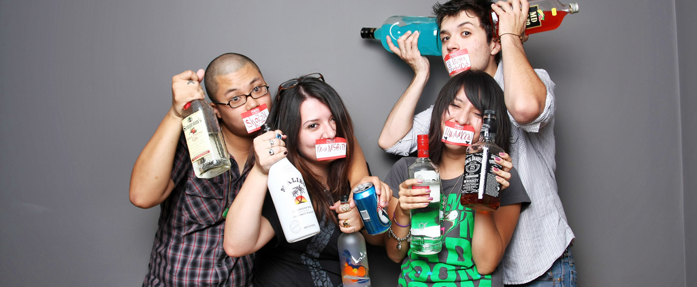
Welcome/Introductions

Slide 3
Goals
Get experience with front/back end
Able to talk and explain the basics to interviewers
Grasp of fundamentals
Get exposure to a lot of things so you know what you don't know

Slide 4
Goals
Public facing examples of projects you've done
Learn how to grow on your own
Figure out if web development is for you
Become a killer paper origami artist

Slide 5
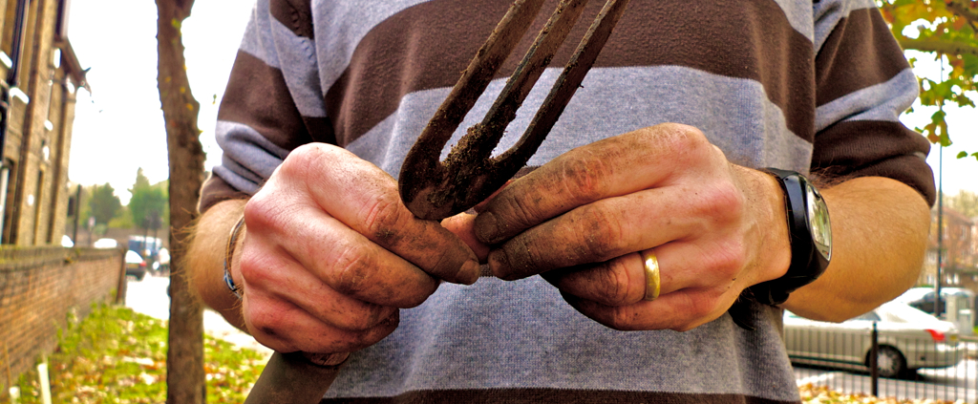
Experience front/backend

Slide 6
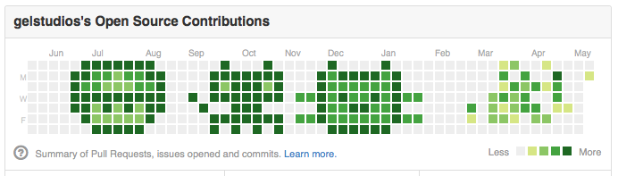
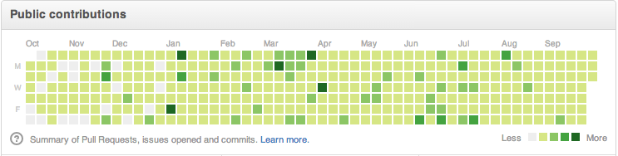
Get Better
From this
To this

Slide 7
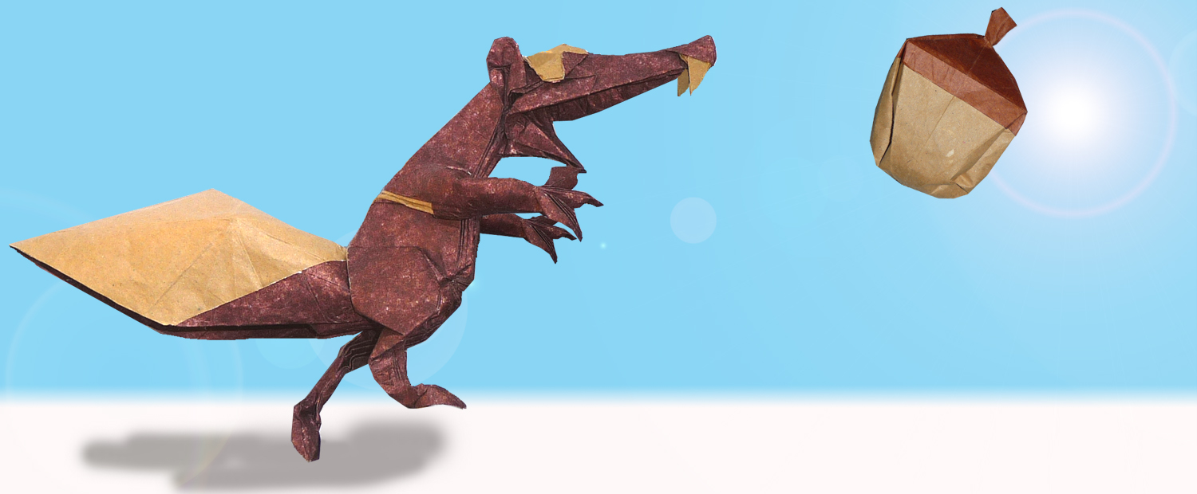
Killer origami artist

Slide 8
Expectations
We're not here to hold your hand
Come prepared
Pace will be quick and builds on previous weeks
Unlike military boot camp you can leave at any time
We value and encourage feedback

Slide 9
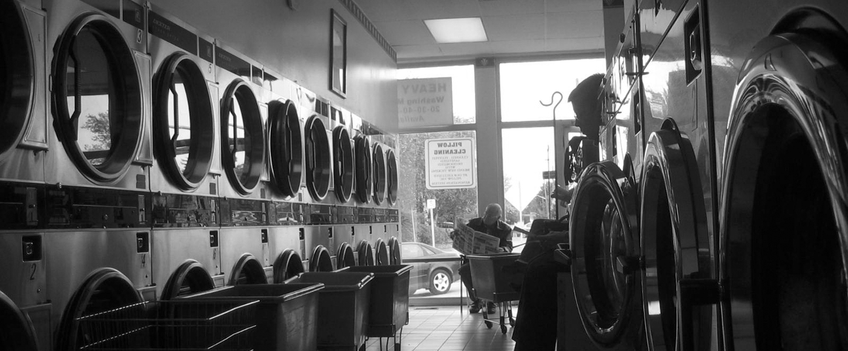
Not here to hold your hand

Slide 10
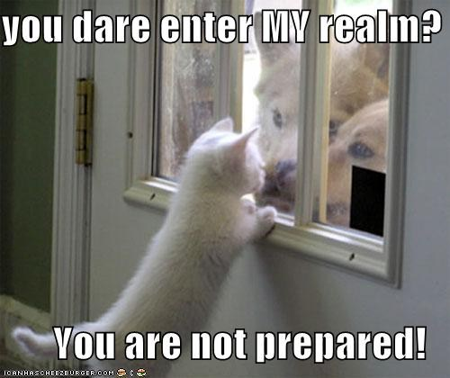
Come prepared

Slide 11
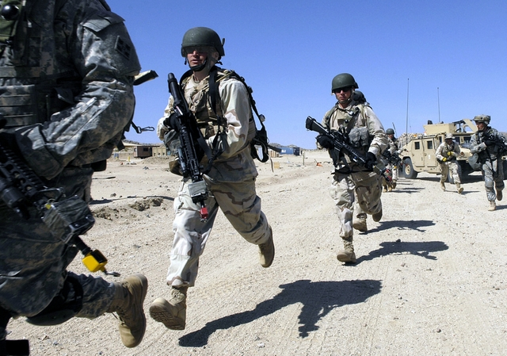
Fast pace, leave at any time

Slide 12
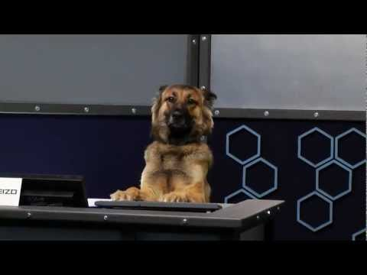
Feedback

Slide 13
Setup
Sublime Edit
Package Manager
Required packages
Node
Git
SourceTree
TR Boot Camp Org on github.com

Slide 14
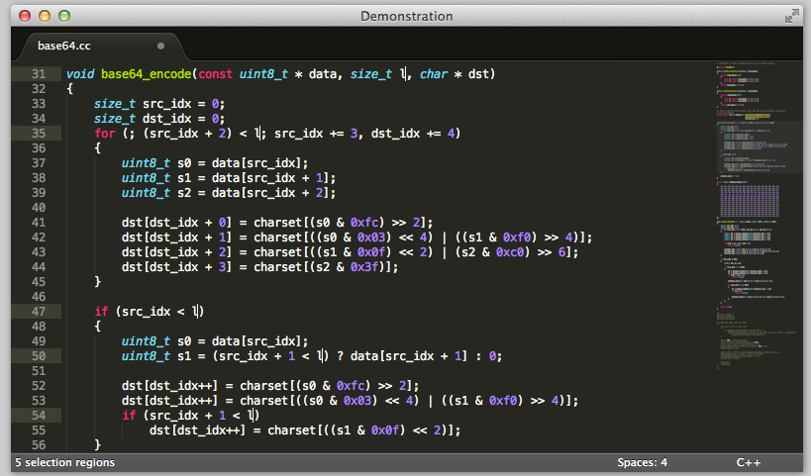
Sublime Text
www.sublimetext.com
sublime.wbond.net – package manager

Slide 15
Node, SourceTree
www.nodejs.org
www.sourcetreeapp.com

Slide 16
Git Introduction
init
clone
checkout
commit
push
pull

Slide 17
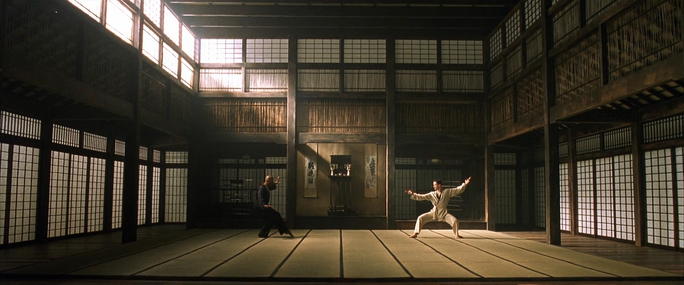
Practical Exercise

Slide 18
Wrap Up
Friday 4pm – 6pm office hours
Come hang out!
BYOB
Let us know you’re coming
Email any time
nick@talentriot.com
stepan@talentriot.com
fernando@talentriot.com
jon@talentriot.com
Weekly assignments due before next talk

Slide 19

Questions?
Stepan Mazurov
stepan@talentriot.com

